Slide 1
Assembly Guide Compliant Baseball Version

Slide 2
Improvements
Test out different materials
TPC more elastic less damping
TPU90A or TPU85A less dense material, so lighter but less stiff
TPE ??
VarioShore can change the density and with that change the stiffness
All of them need proper tuning of the print settings in order to print well

Slide 3
Manufacturing
Making the axes
Follow the technical drawings
The drive axis can be made on a lathe
The fixed axis can be done on a milling machine or by hand with some additional aiding pieces to drill in a round bar

Slide 4
Manufacturing
Printing the pulleys
Print settings
Infill rate is 15%
You can print two at the same time
Support can be added to make the v-shape better
Best if dissolvable support is used
See print settings for PLA

Slide 5
Manufacturing
Printing the CFM
Print settings
Infill rate is 80%
You can print two at the same time
No support needed
See print settings for TPU 95A

Slide 6
Manufacturing
Printing the Bumper
Print settings
Infill rate is 15%
Add support for the top part
See TPU print settings

Slide 7
Manufacturing
Printing the shell
Print settings
Infill rate is 15%
You can print two at the same time
Printed with 1 wall thickness
Used fuzzy skin to increase the wall thickness on the outside (Use the modifiers in the print file)
Add instruction on how to add the Fuzzy skin
See print settings for TPU 95A

Slide 8
Manufacturing
Printing the suspension
Print settings
Infill rate is 15%
You can print two at the same time (depending on the bed size)
No support needed
See TPU print settings

Slide 9
Assembly
Assembly Drivetrain
Solder all the components on the PCB, except for the battery holder
Adjust the cable of the servo motor to fit the connector on the PCB
Modify one of the asseccories of the servo motor to be used to tighten the drive axis on the motor
Add a little bit of loctide or instant glue to the drive axis thread and attach the drive axis to the motor
Insert the bearings in the CFMs
Small bearings at the motor
Large bearings at the fixed axis
Snap the CFMs in the PCB
Make sure it is orientated in the right way
Insert the battery holder and solder it in possition
Insert the nut and set screw to both pulleys
Insert the motor with axis through the bearings and make sure to place the pulley and belt in between the CFMs
Insert a screw to attach the motor to the CFM
Tighten the set screw in the pulley with a little bit of loctide
Add the bumper
Insert fixed axis through the CFMs with the pulley and belt in between
Tighten the pulley again with a little bit of loctide on the setscrew

Slide 10
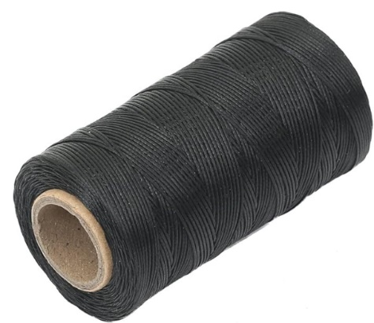
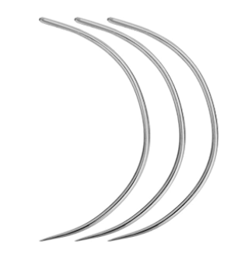
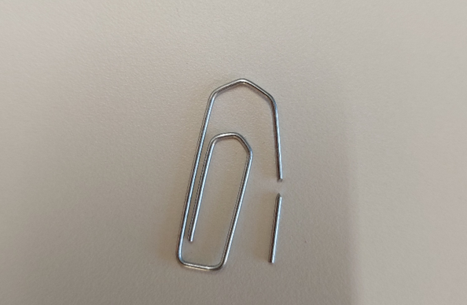
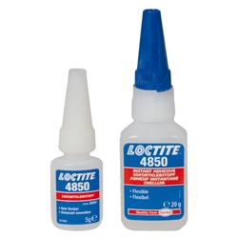
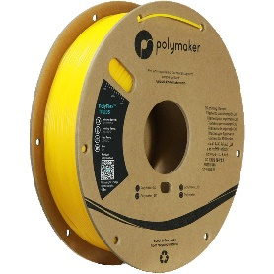
Assembly
Assembly Half shells
Put alignment pins in one half
Glue shells together with flexible glue, make sure the two halves align
Don’t use to much glue, hazing will occur (turning white), and the glue will prevent proper welding of the two halves later
Glue it only to keep it in place for the welding part
Let the glue dry (at least an hour)
Prepare the welding of the two halves
Weld
Let it cool down (at least an hours)

Slide 11
Assembly
Assembly Suspension
Insert the suspension hubs in the shell. Do this by press fitting it through like in the picture

Slide 12
Assembly
Assembly Whole ball
Start stitching the first half of the ball
Connect the suspension hubs to the fixed axis with the drivetrain in the middle
Use the pins to do so
Finish the stitching of the rest of the ball

